Slide 1
State-Level Opiate Related Deaths 1999-2014
Analytics & Data Science
Johnny Cagno

Slide 2

Data:
Data provided by the CDC, provides information on opiate related deaths and the number of prescribed opiates by state by year.

Slide 3

Goal:
Create R Shiny App that allows users to gather a broad understanding of the opioid epidemic in the USA on a state and national level.

Slide 4
The App:
https://johncagno.shinyapps.io/OverdosesApp/

Slide 5
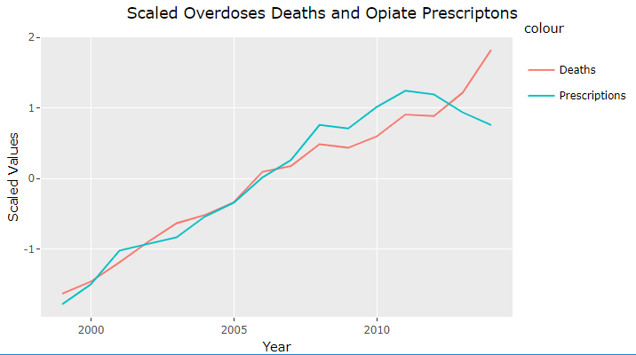
The number of prescribed opiates peaked in 2011
The increase in opiate related deaths did not stop.

Slide 6
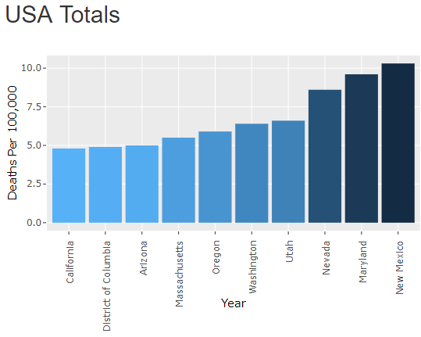
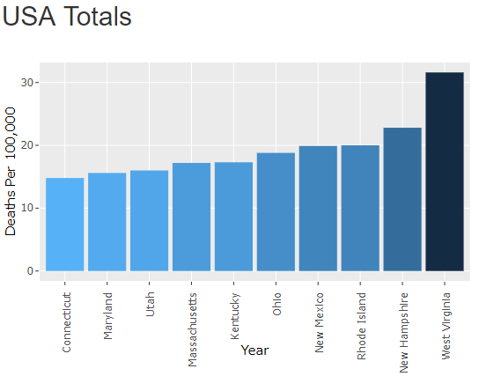
1999
2014

Slide 7


1999 - 2014
West Virginia
Deaths per 100,000 increased 1563%
New Hampshire
Deaths per 100,000 increased 570%

Slide 8

Conclusions:
Opioids are killing tens of thousands of Americans every year
The opioid epidemic in the USA is continuing to worsen, fentanyl is playing a major role
The economic cost is over $500 billion/year

